Slide 1

Car accident severity
Capstone Project

Slide 2
Background
High number of road traffic accidents
Over 3000 people dying on the world's roads every day
Can Data Science help to predict the Severity of Car Accidents?
Development of Machine Learning Algorithms
Identification of the trend and patterns in the data
Benefiting from an automated mining process
The capacity present for the improvement

Slide 3
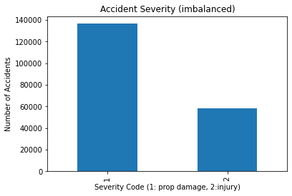
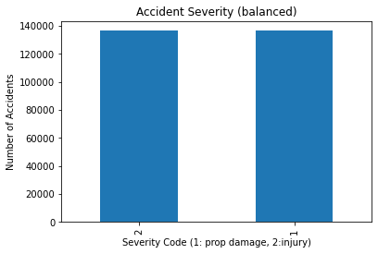
Data
Data Understanding and Preparation
Data Source
Provided by the SDOT Traffic Management Division
Traffic Roads Group, Seattle (2004_Present)
Data Balancing: Using resampling technique
Data Cleaning
Identify and handling of missing values
For numeric values by mean
For categorical values by the frequency
Conversion of categorical values to numeric values

Slide 4
Feature Selection
 | Feature | Description
1 | LONGITUDE | Longitude
2 | LATITUDE | Latitude
3 | PERSONCOUNT | Total number of people involved in the collision
4 | VEHCOUNT | The number of vehicles involved in the collision
5 | JUNCTIONTYPE | Category of junction at which collision took place
6 | INATTENTIONIND | Whether or not collision was due to inattention
7 | WEATHER | A description of the weather conditions during the time of the collision
8 | ROADCOND | The condition of the road during the collision
9 | LIGHTCOND | The light conditions during the collision
10 | SPEEDING | Whether or not speeding was a factor in the collision
Dropping irrelevant information including:
The inter-organizational codes
Redundant descriptive values
Repeating values

Slide 5
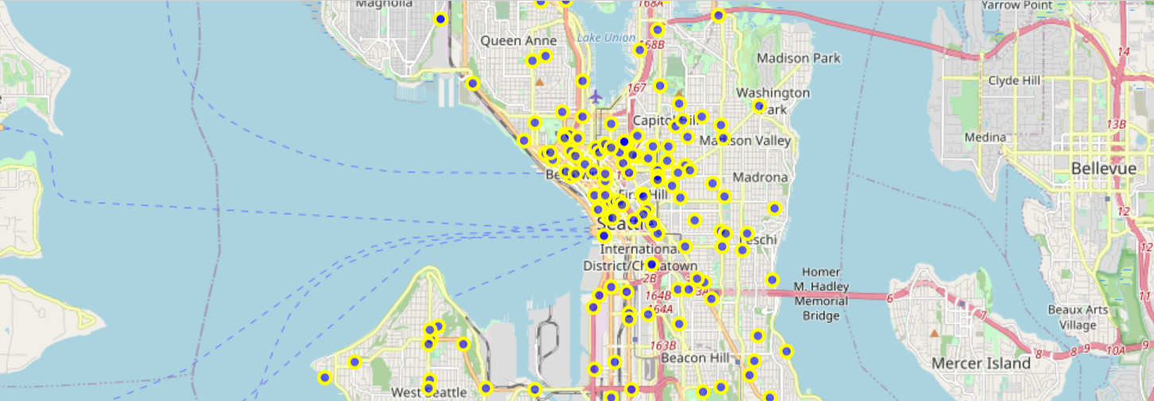
Explanatory Data analysis_1
The map with markers of the accident locations in Seattle (300 data points)

Slide 6
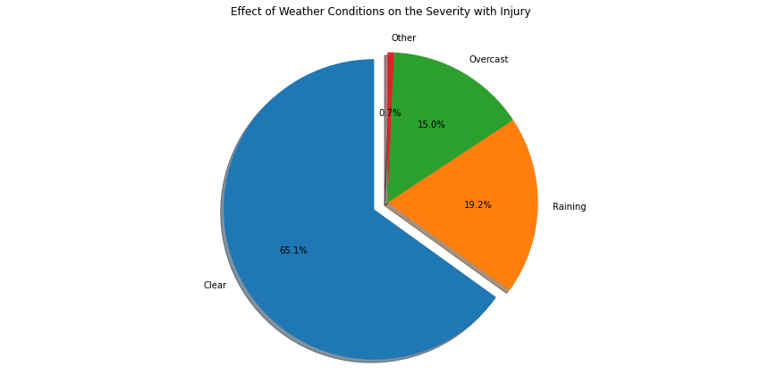
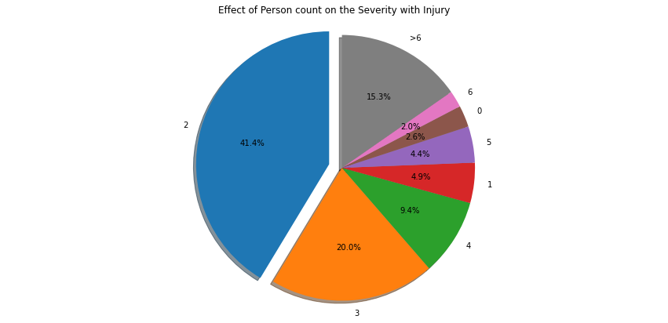
Explanatory Data analysis_2

Slide 7
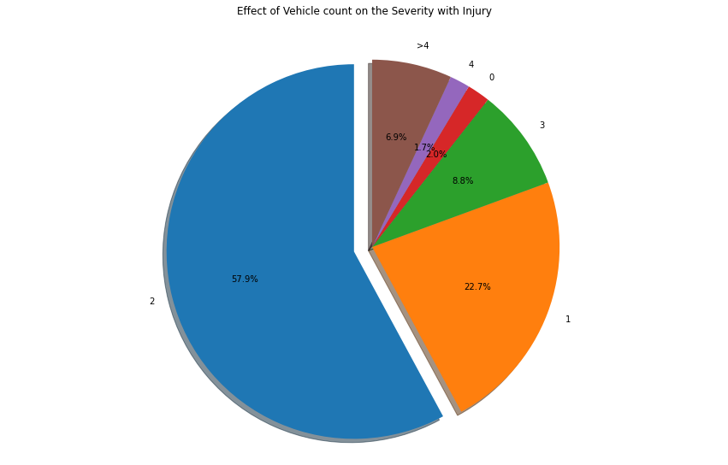
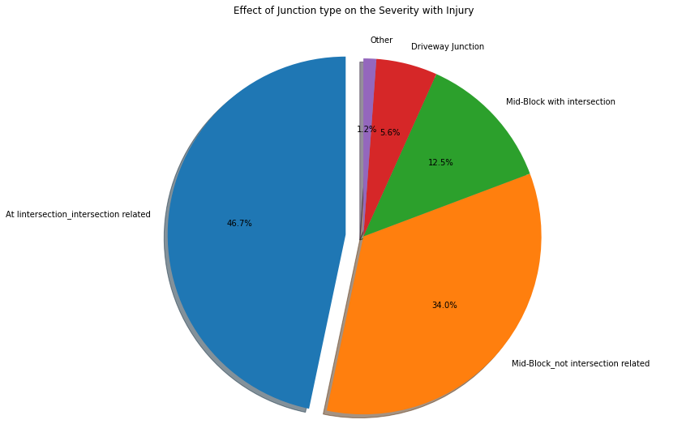
Explanatory Data analysis_3

Slide 8
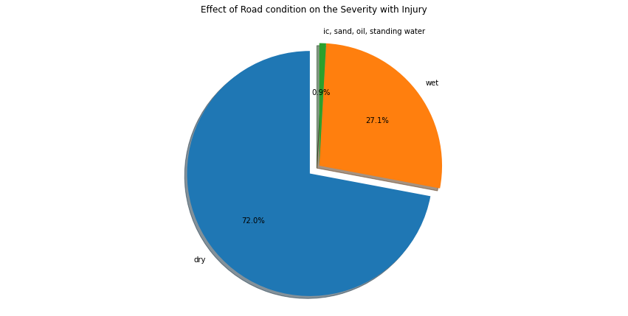
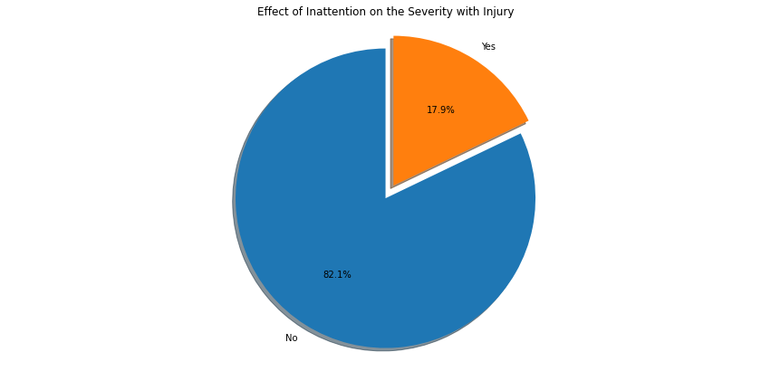
Explanatory Data analysis_4

Slide 9
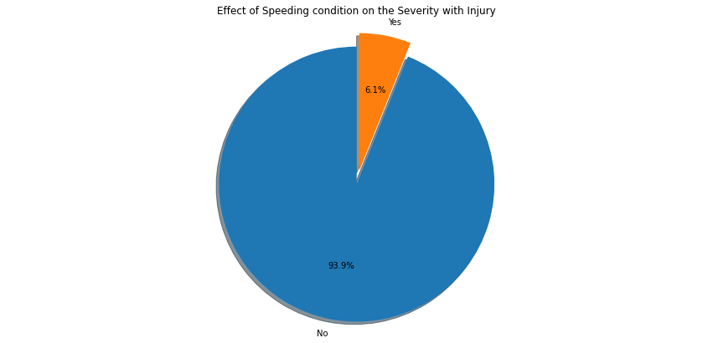
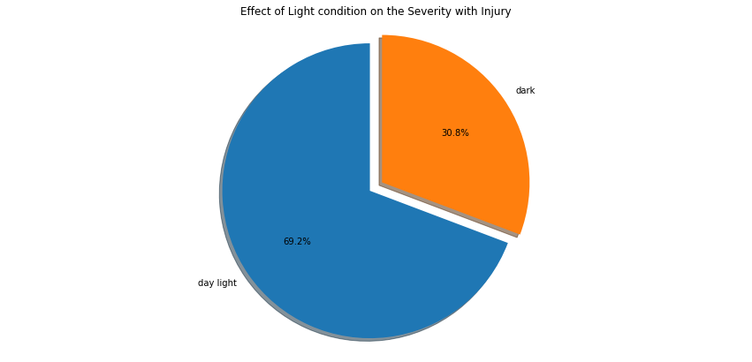
Explanatory Data analysis_5

Slide 10
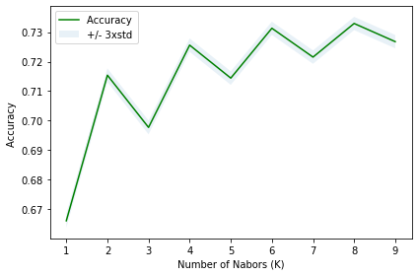
Modeling, Evaluation and Testing_1
Normalization of the data
Using preprocessing standard scalar
Splitting into train-test sets
80% training set
20% test set
Modeling using K-Nearest Neighbors
KNN classifier
Best K =8
Obtained KNN accuracy = 0.73

Slide 11
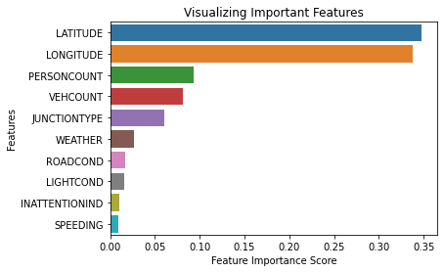
Other applied classification techniques
Decision Tree
Obtained Accuracy = 0.74
Logistic Regression
Obtained Accuracy = 0.7
Random Forest
Obtained Accuracy= 0.71
Modeling, Evaluation and Testing_2

Slide 12
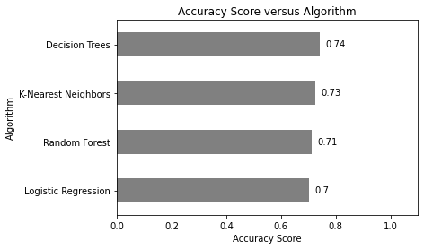
Decision Tree
Better accuracy score
More compatibility with the unscaled data
Less sensitivity to the missing values
Modeling, Evaluation and Testing_3

Slide 13
Conclusion and Outlook
The dataset has been balanced and further prepared for the predictive modeling analysis.
Four classification algorithms are employed
K-Nearest Neighbors
Decision Tree
Logistic Regression
Random Forest
Evaluation and testing of the created models
Decision Tree has shown better accuracy and more computability for the given dataset.
Idea for future work
Development of the decision Tree to improv its accuracy
Addition of more data to the dataset to compensate for the missing values
Taking other factors such as the age of car drivers into account for the prediction of accident severity

